Slide 1
CMPE 343 Week 06 NLP
Name Entity Recognition

Slide 2
Information Extraction IE
Name Entity Recognition
Relation Extraction
Event Extraction
Temporal expression

Slide 3
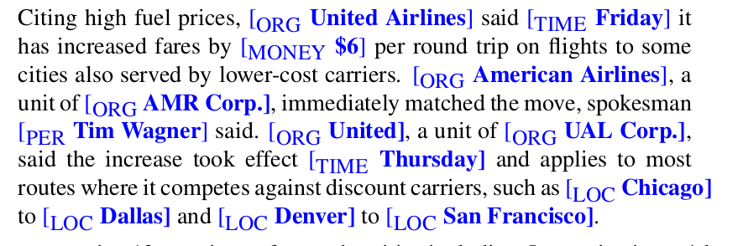
NER

Slide 4
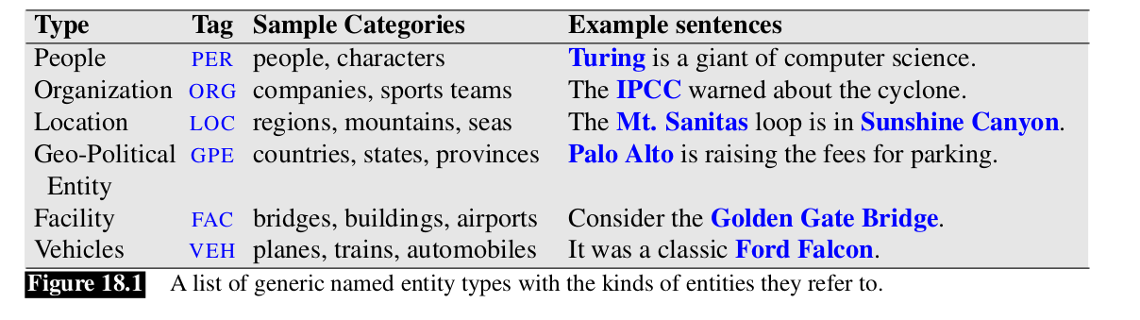
Generic Name Entities

Slide 5
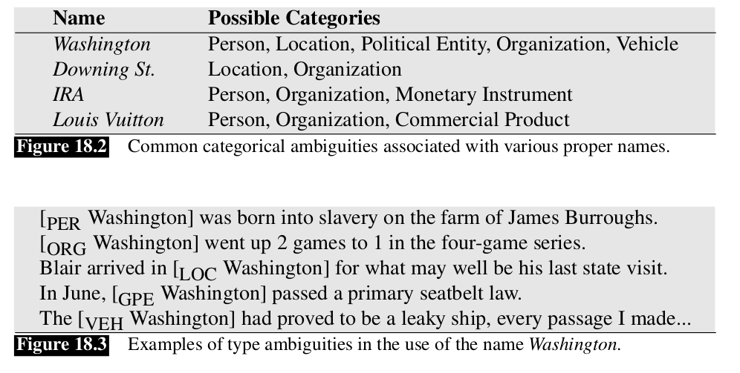

Slide 6
Sequence Labeling
MEMM Maximum Entropy Markov Model
CRF Conditional Random Field
Bi LSTM

Slide 7
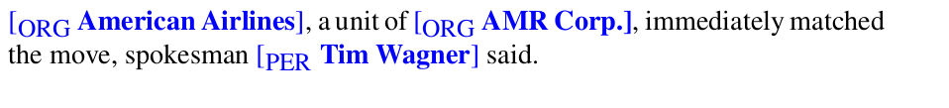
NER as Sequence labeling

Slide 8
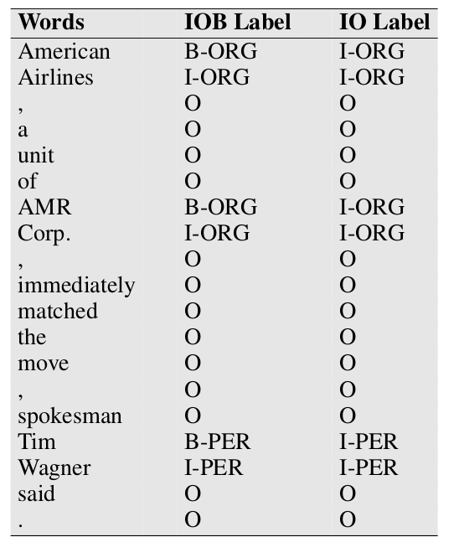
[ ORG American Airlines], a unit of [ ORG AMR Corp.], immediately matched the move, spokesman [ PER Tim Wagner] said.

Slide 9
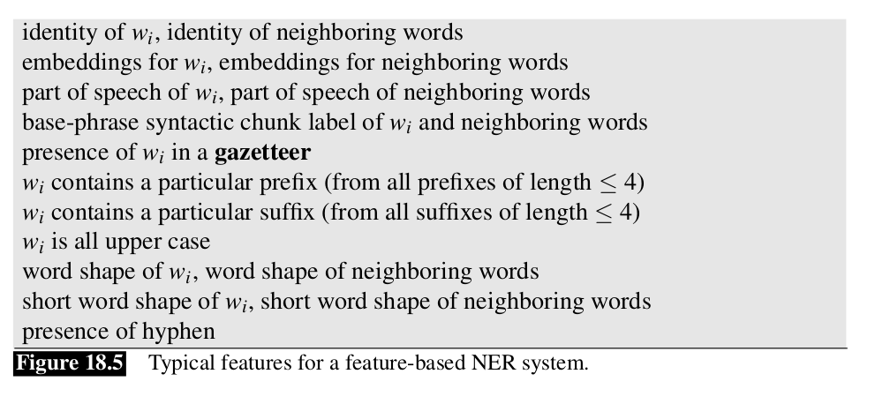
Feature Based NER

Slide 10
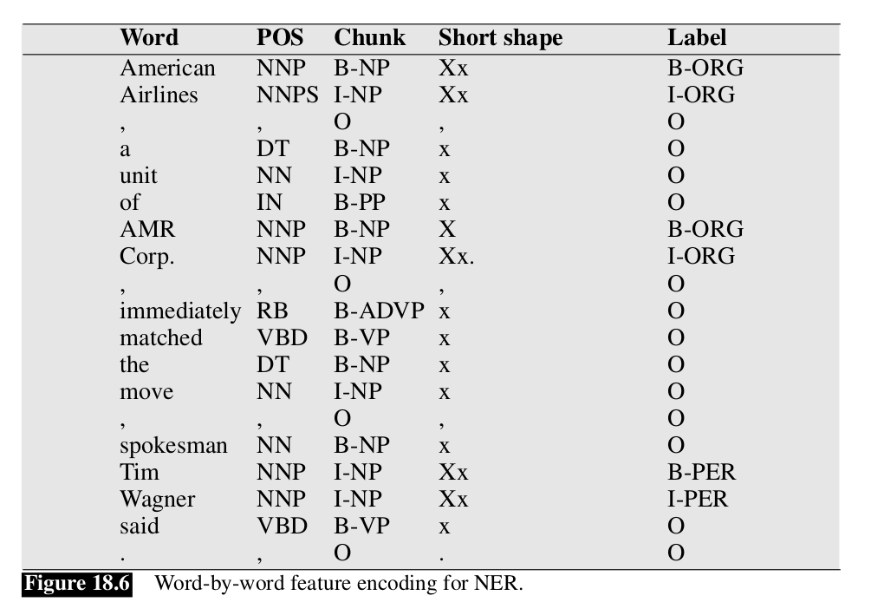

Slide 11
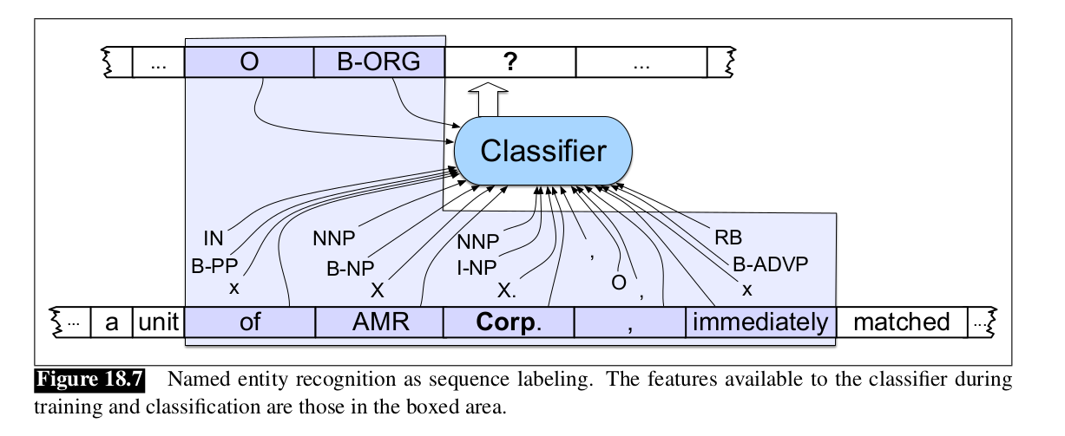

Slide 12
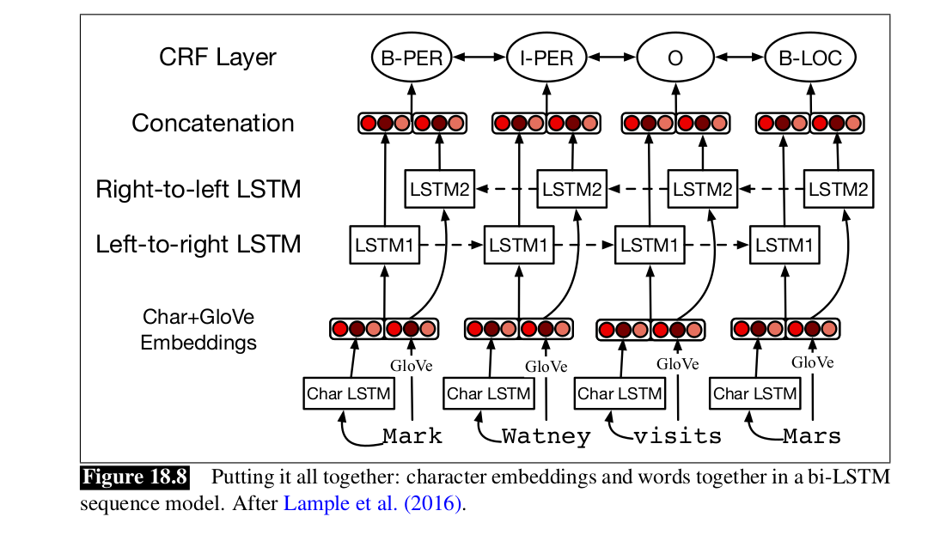
Neural Alg for NER

Slide 13
Rule based Approaches
For example IBM System T is a text understanding architecture in which a user specifies complex declarative constraints for tagging tasks in a formal query language that includes regular expressions, dictionaries, semantic constraints, NLP operators, and table structures, all of which the system compiles into an efficient extractor

Slide 14
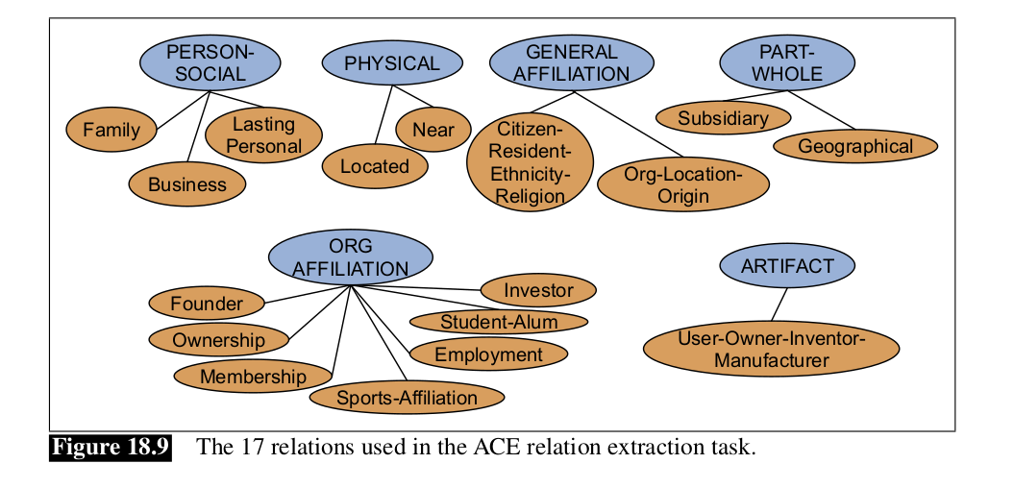
Semantic Relations

Slide 15
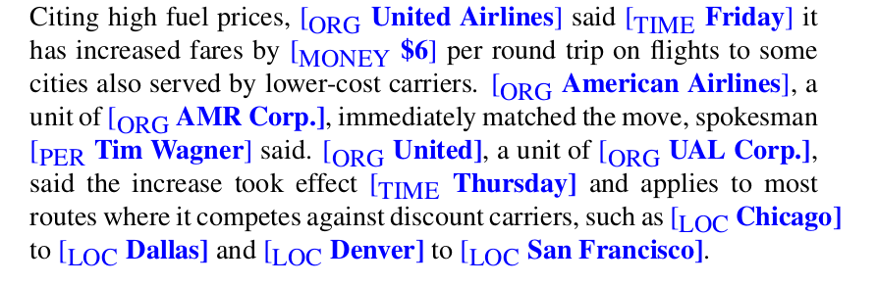
Semantic Relation

Slide 16
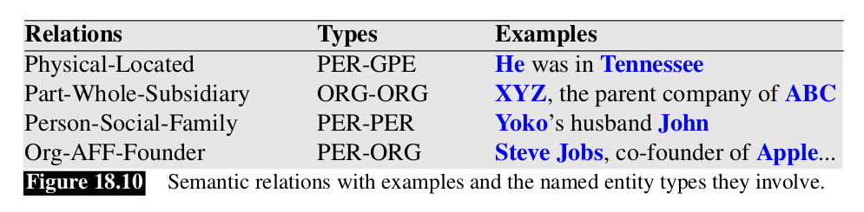

Slide 17
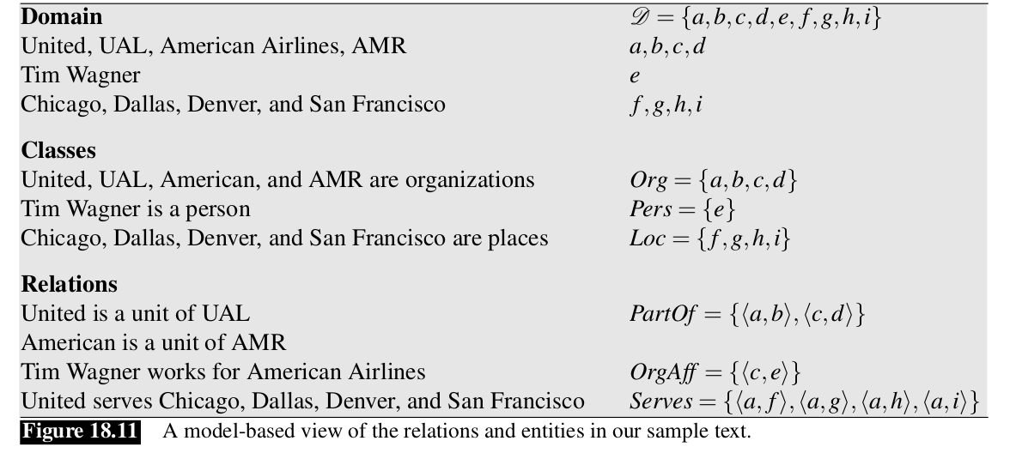

Slide 18
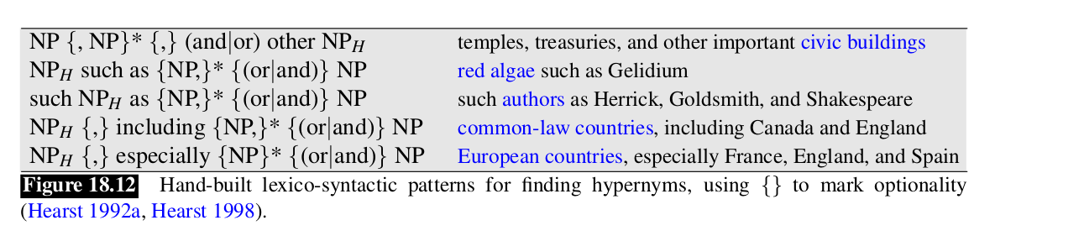
Using Patterns to Extract Relations

Slide 19
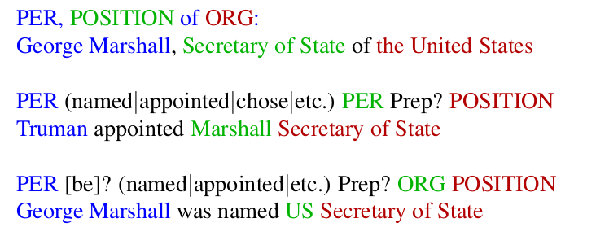

Slide 20
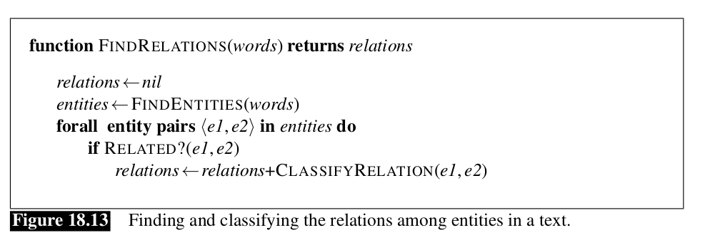
Via Supervised Learning

Slide 21
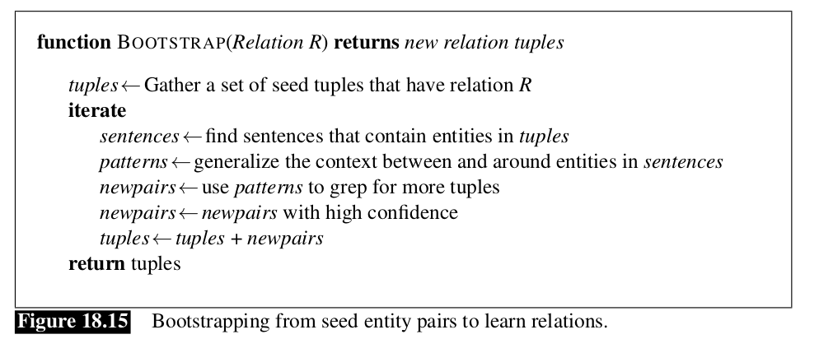
Semi Supervised Learning

Slide 22
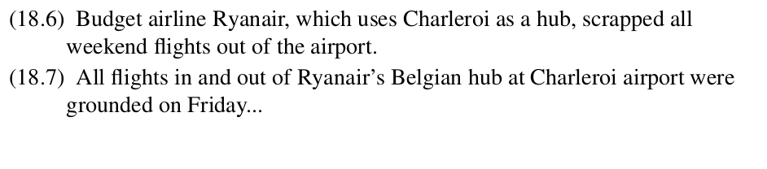
Pattern Generalizing

Slide 23
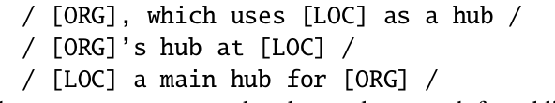
Pattern

Slide 24
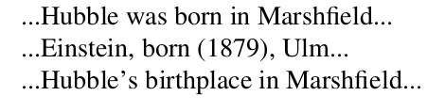
Distant Supervision
In the seed-based approach, we might have only 5 examples to start with. But Wikipedia-based databases like DBPedia or Freebase have tens of thousands of examples of many relations; including over 100,000 examples of place-of-birth, (<Edwin Hubble, Marshfield>, <Albert Einstein, Ulm>, etc.,).

Slide 25
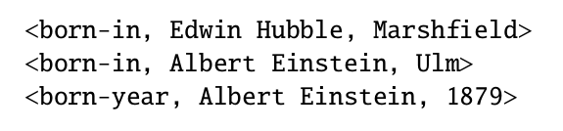

Slide 26
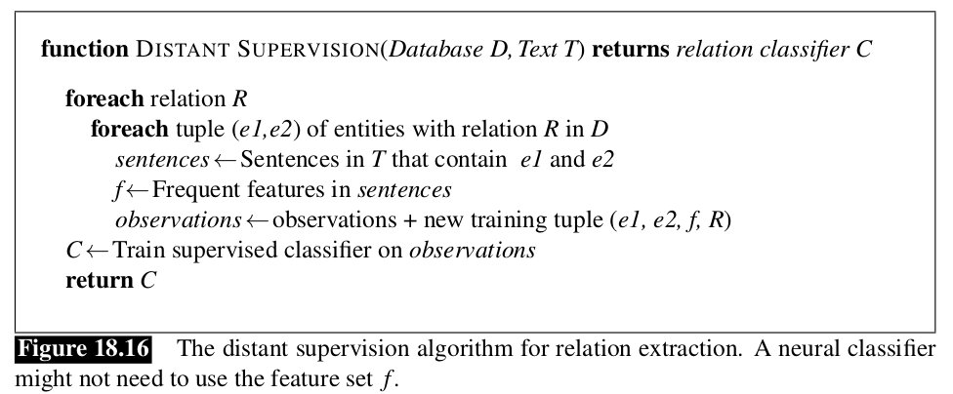

Slide 27
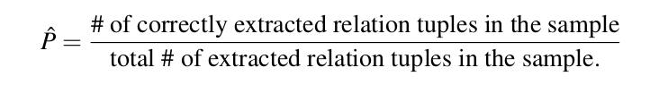
Evaluation

